Slide 1




Salary Survey
Analysis
Presented By :
M.Pavithra
DADS JULY A COHORT

Slide 2
Project Overview
  The dataset contains salary information from people working in different countries, industries, education levels, and experience ranges.
  However, the raw data does not clearly show how salaries change across these groups.
  The project aims to organize and analyze this data to understand salary differences and identify important patterns.

Slide 3
Project Objective
  To clean and organize the salary dataset for accurate analysis.
  To use MySQL queries to explore salary trends and compensation patterns.
  To identify differences in salary based on country, industry, education, and experience (Using Pivot tables and Charts).
  To create an interactive Excel dashboard with KPIs, slicers, and charts.
  To provide clear insights that help understand salary distribution and support better decision-making.

Slide 4
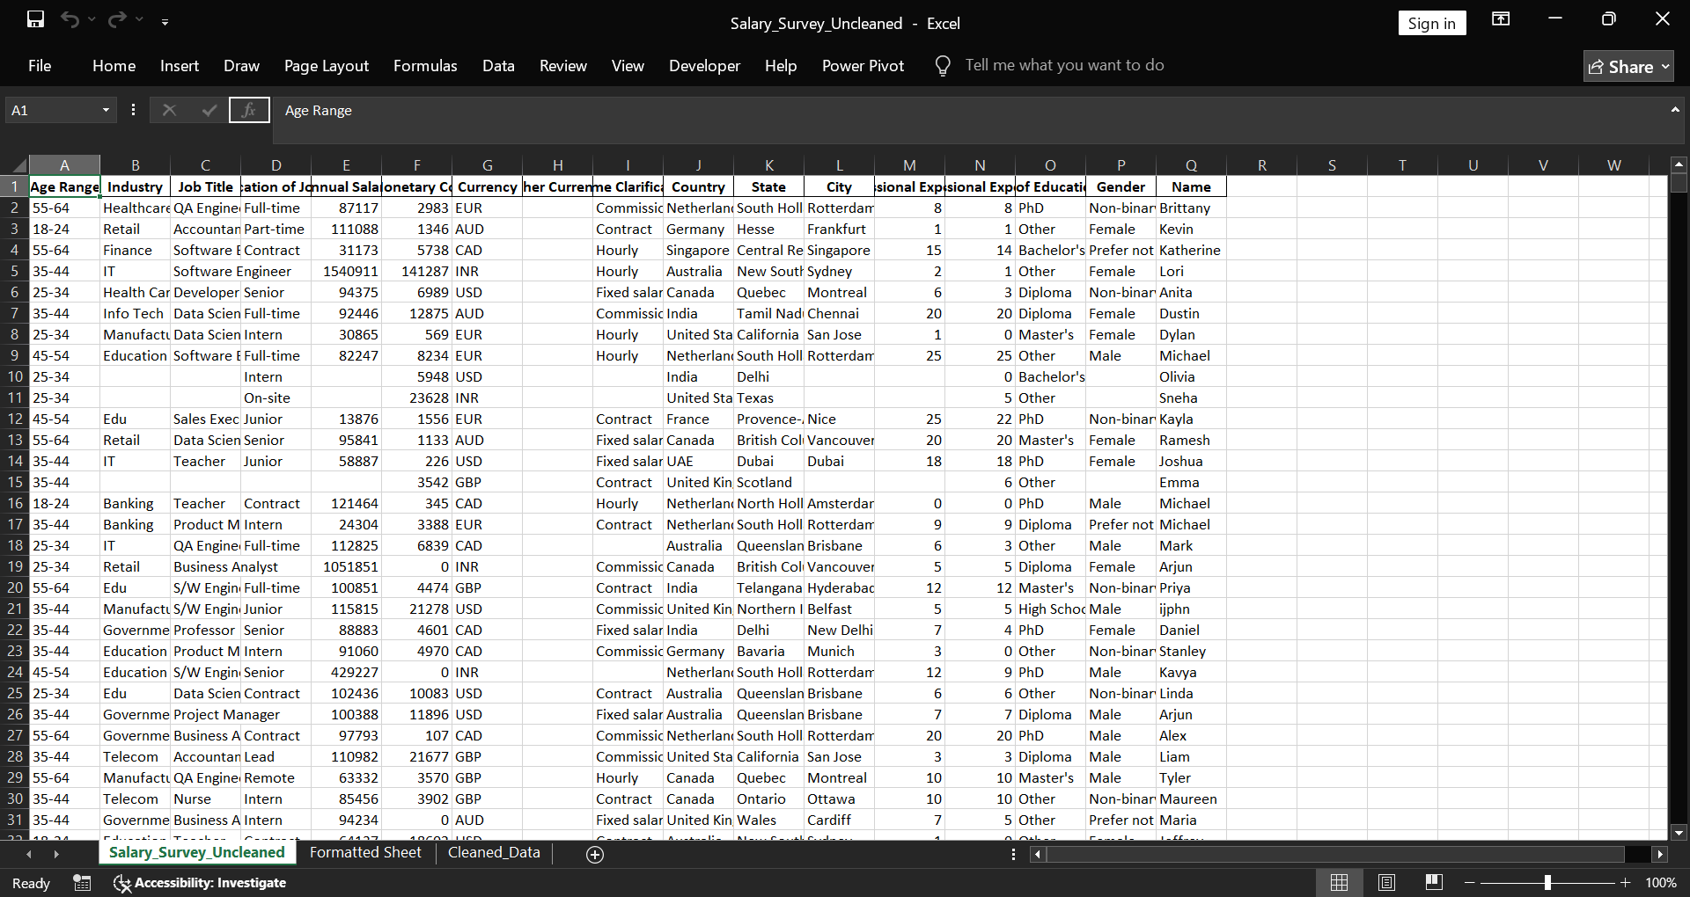
Dataset Overview
Dataset - Global Salary Survey
Raw Dataset
Key Attributes
  Salary
  Additional compensation
  Job title
  Education
  Experience
  Country
Rows - 1021
Columns - 17

Slide 5
Data Cleaning
  Removed duplicate records and unnecessary column like Other Currency.
  Handled missing values in Annual salary, compensation fields, education, industry (median values, ‘unknown’ & ‘Not Specified’).
  Standardized formats all columns (text, numeric etc).
  Converted all other currency formats to USD currency format for better analysis.
  Normalized categorical fields by fixed inconsistent spellings and capitalization.
  Identified outliers by using conditional formatting and handled outliers using Interquartile (IQR) method.
  Finally, the dataset is verified and saved the cleaned dataset as Salary_Survey_Cleaned in CSV format to perform MySQL queries.

Slide 6
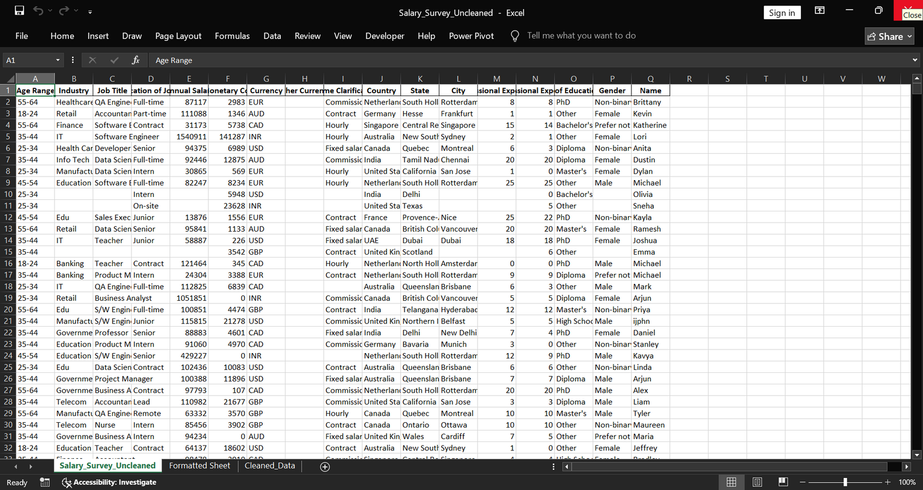
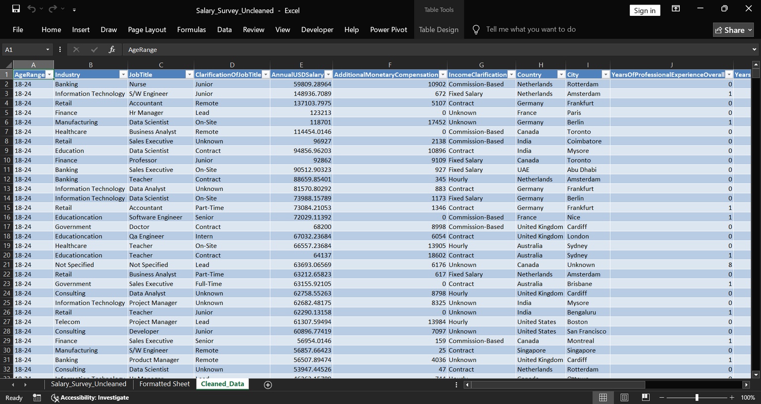
After Cleaning
  Duplicates - 46
  Rows - 975
  Columns - 14
Before Cleaning
After Cleaning

Slide 7
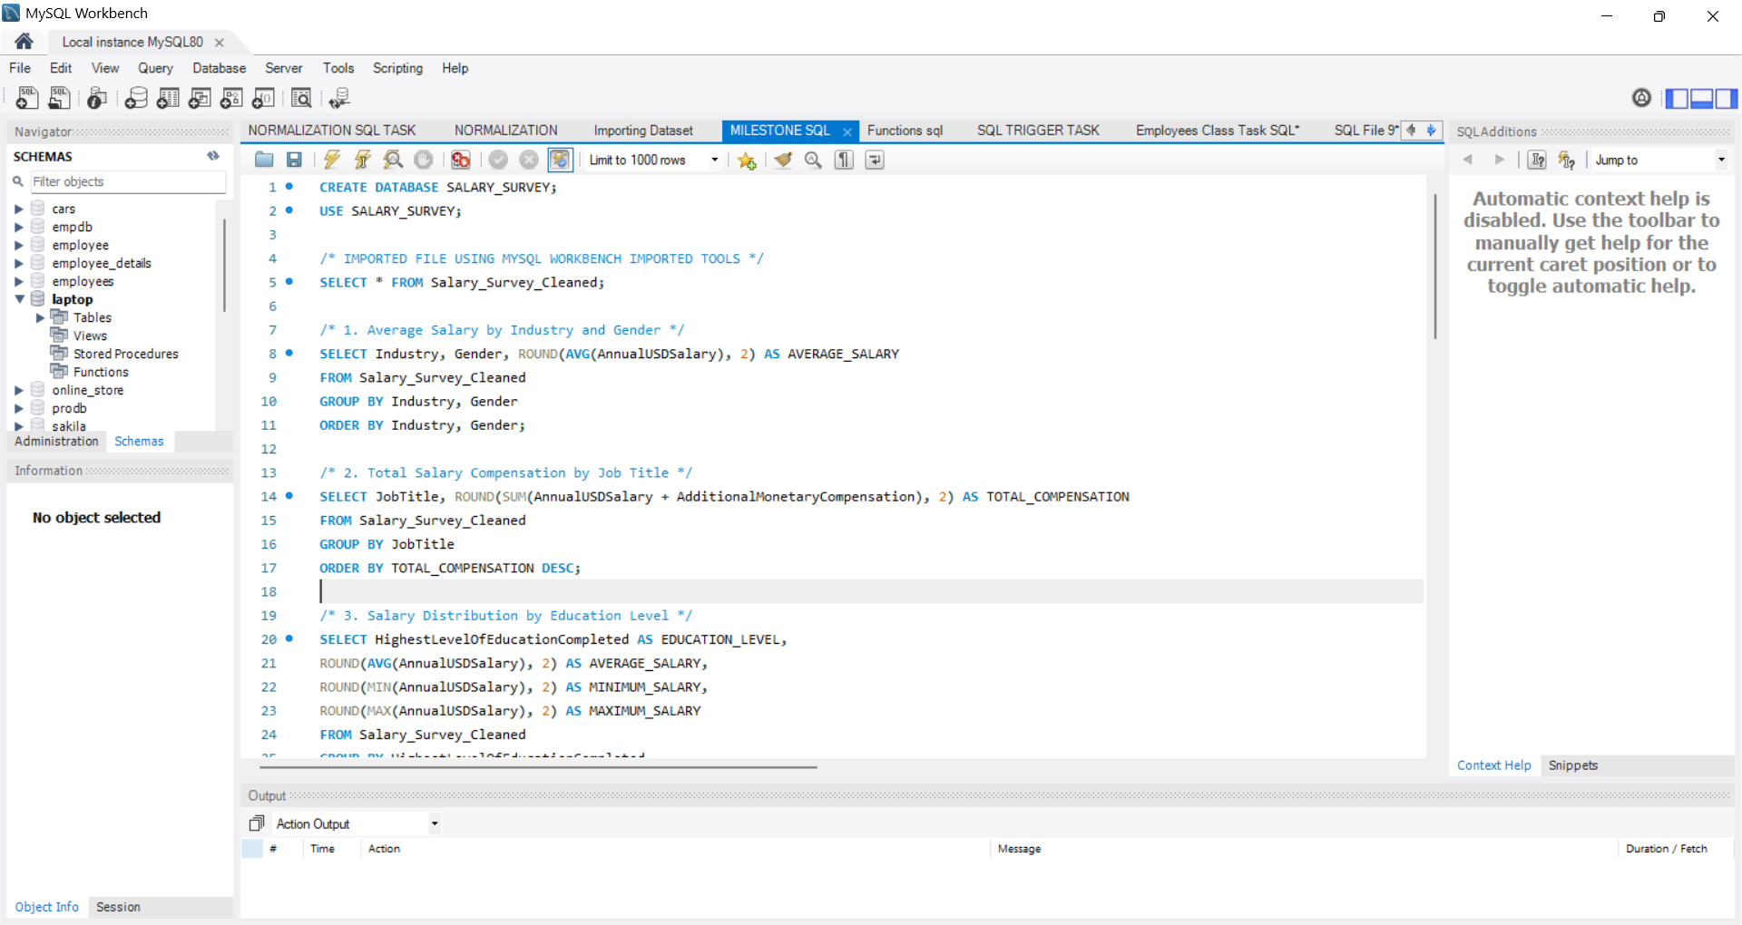
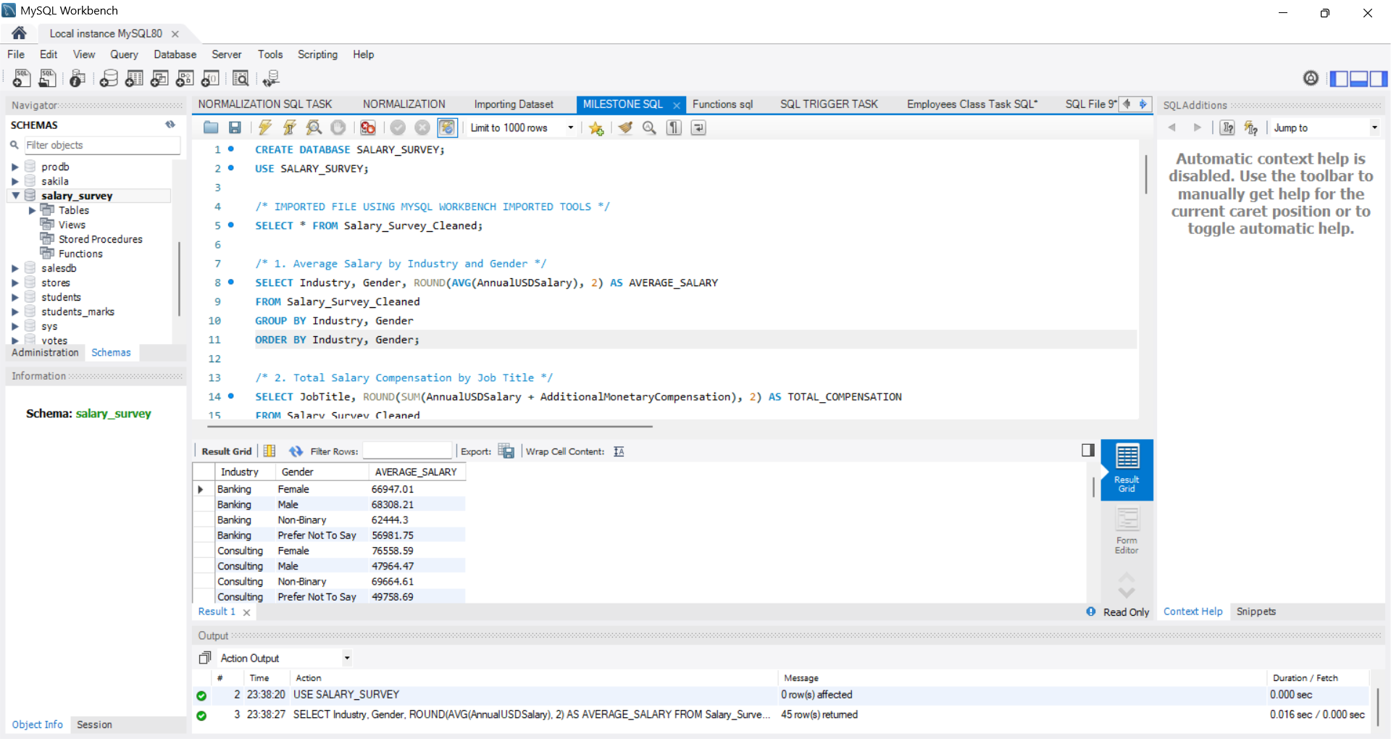
Key MySQL Insights
Imported my Salary_Survey_Cleaned CSV file into MySQL Workbench using Table Data Import Wizard.
  Average salary by industry & gender
  Total compensation by job title
  Salary vs education level
  Employees by industry & experience
  Median salary by age & gender
  Highest salary by country
  Salary by city & industry
  Compensation trends by gender
  Total comp by job & experience
  Salary by industry, gender & education

Slide 8
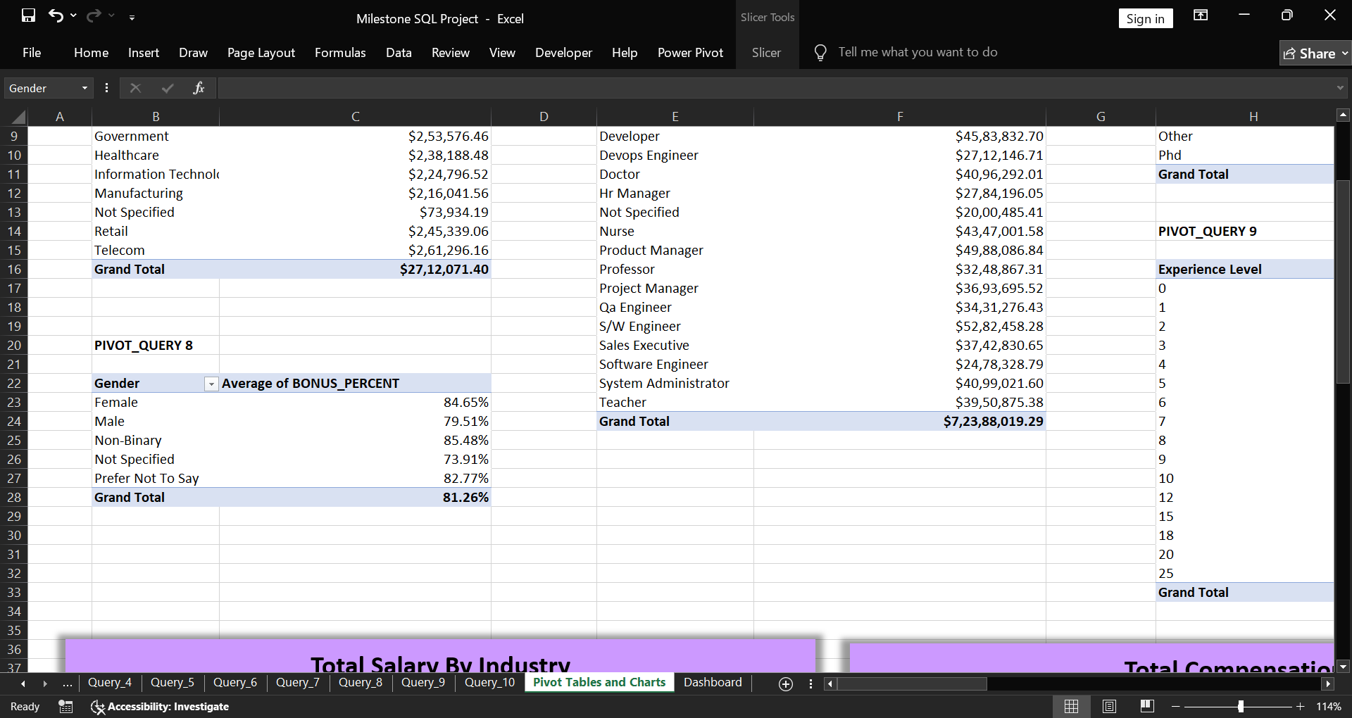
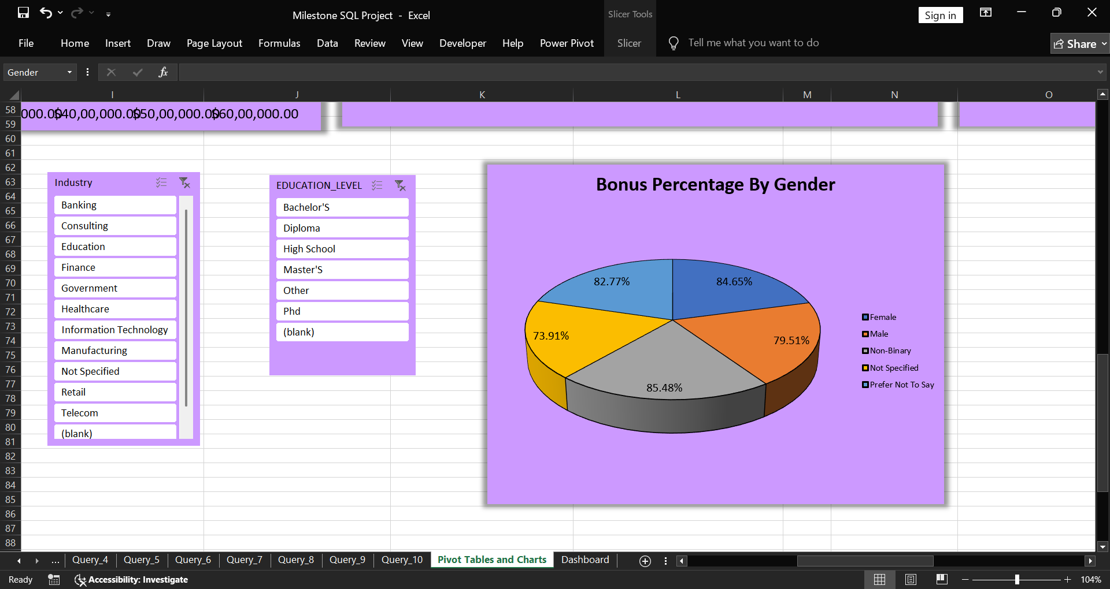
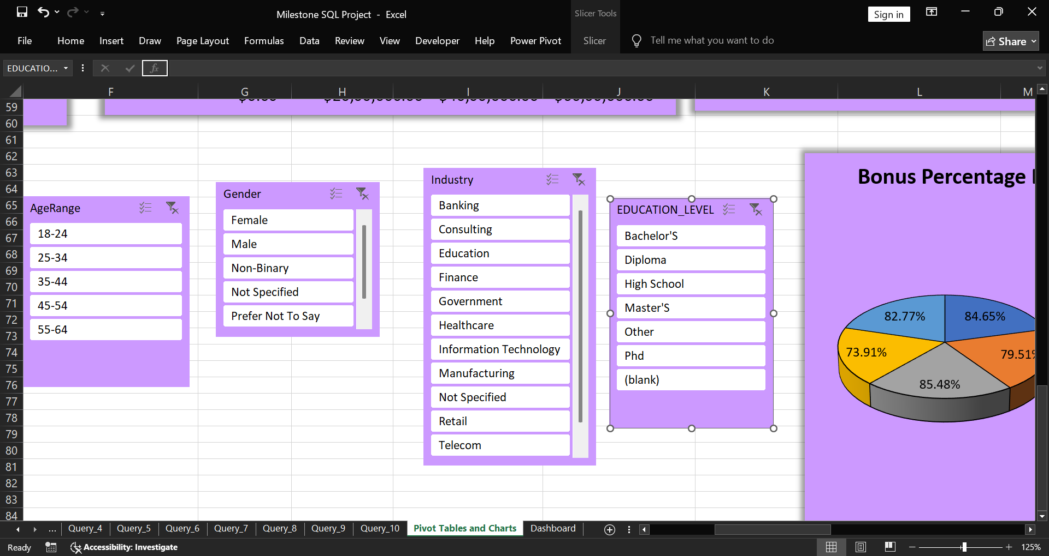
Pivot Table & Chart
Created Pivot Tables for each queries & respective Charts and Slicers to create interactive Dashboard.

Slide 9
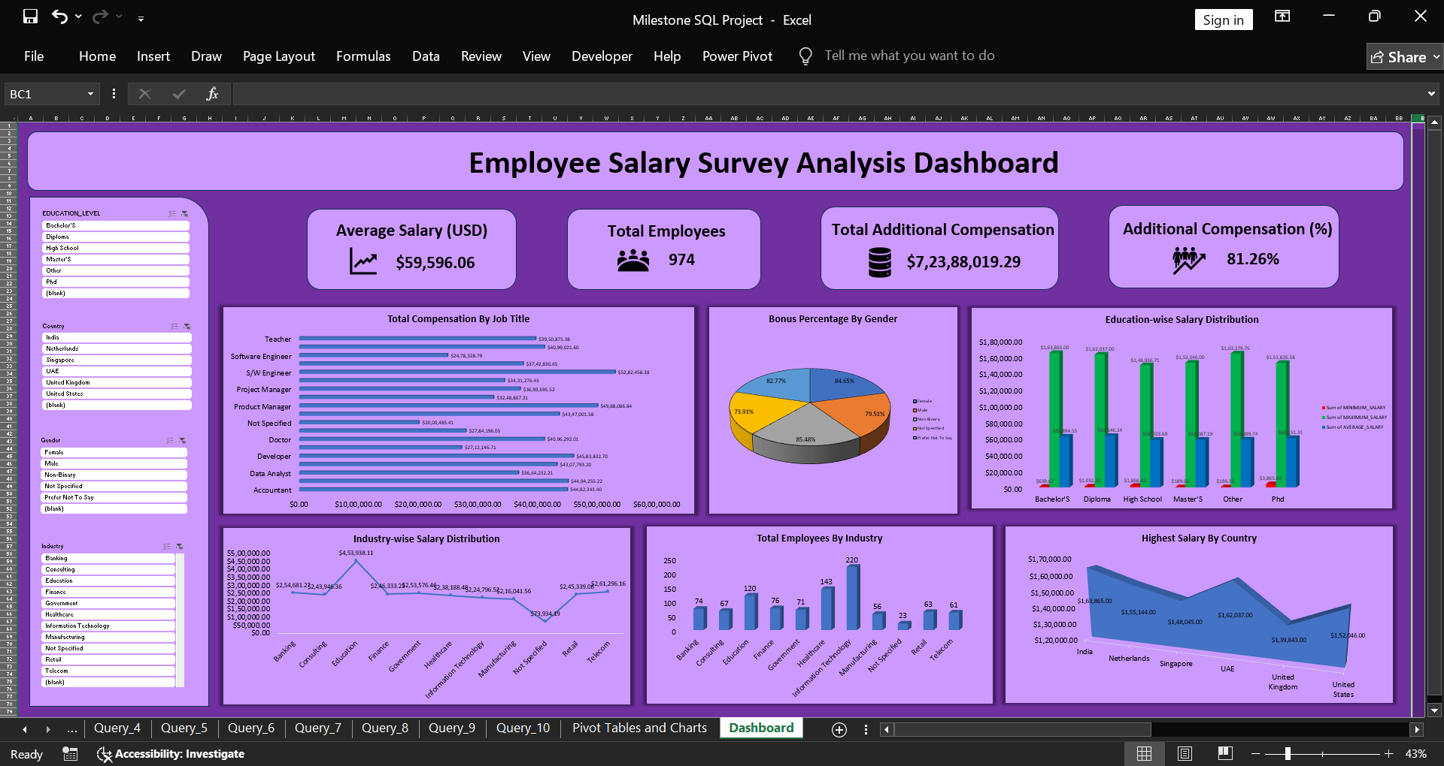
Dashboard Overview

Slide 10
Overall Insights
  Higher education around $45k leads to better salary packages.
  Software Engineer attained high compensation around $52M comparing to all other Job Titles.
  The highest Salary achieved by India around $163k followed by UAE around $162k whereas the Lowest salary across countries is United Kingdom around $140k.
  Comparing to all other fields, Information Technology has the highest number of employees in the Industry.
  Non-Binary (85.48%) in Gender received highest bonus percentage followed by Female (84.65%).

Slide 11
Conclusion
  The raw uncleaned dataset is formatted, cleaned and imported into MySQL.
  Queries were performed to understand the salary trends.
  Created Dashboard for visualization of salary and compensation patterns across various attributes.
  Experience, education, and industry strongly influence salary levels.
  IT, Finance, and Healthcare are the top-paying industries.
  India has the highest average salary in the dataset.
  Overall the project gives the better visualization and insights which support better decision making.

Slide 12
Recommendations
  Encourage skill development to increase employee value.
  Ensure fair pay across gender and similar job roles.
  Offer bonuses or incentives to retain skilled workers.
  Review salaries regularly to stay competitive.
  Use dashboards to track salary and experience trends.
  Promote transparency in salary structure to build employee trust.
  Focus on hiring in high-growth industries where salary trends are increasing.
  Compare pay with other industries to stay updated.
  Keep data clean and updated for better HR analysis.

Slide 13
Thank You

